Slide 1
Paraphrasing of Predicates for Question Analysis in QA system
Xusheng Luo
Adviser: Kenny Q. Zhu
2015.6.25

Slide 2
Motivation
Question and Answering
Q: Where does Obama live?
A: Washington DC
1
Notes:
As the title mentioned, the ultimate goal of this project is to help solve the question answering problem, which is a task for machines to answer human-posed questions in natural language.

Slide 3
Motivation
Question and Answering
Q: Where does Obama live?
A: Washington DC
Question Analysis
Answer type inferring
Q: Where does Obama live?
T: Location
1
Notes:
question analysis is always the first step of a qa system, which is to infer the answer type, such as location in this case.

Slide 4
Motivation
Predicate of question
Q: Where does Obama live? P: live in
2
Notes:
here in this project, we mainly focus on the one important component of question, that is the predicate of the question

Slide 5
Motivation
Predicate of question
Q: Where does Obama live? P: live in
Map to Big Data Corpus
<A, live in, B>, <C, lives in, D> …
infer → <person, live in, location>
2
Notes:
once we get the predicate like live in, we map it to a big data corpus and retrieve many triples such as A live in B, C lives in D, then we can further infer the answer type is location in this case,
however, the triples maybe not enough if we only search for live in.

Slide 6
Motivation
Predicate of question
Q: Where does Obama live? P: live in
Map to Big Data Corpus
<A, live in, B>, <C, lives in, D> …
infer → <person, live in, location>
Paraphrasing of predicate
Live in → live at, reside in, be native at…
More <subj, rel, obj> triples !
2
Notes:
so we need to paraphrase the predicates. for example, express live in as live at, reside in and be native at and so on.
then more triples can be retrieved.

Slide 7
Background
Open IE: ReVerb
Source: ClueWeb, large corpus from Web
Data: <subject, relation, object>
Examples:
<Warren Buffett, is a close friend of, Bill Gates>
<Costa Rica, is located in, Central America>
<Alek Wek, was born in, 1977>
…
3
Notes:
the big data corpus we used is an open information extraction system called reverb, which contains millions of triples extracted from the web,
all data has a triplet form. there are some examples.

Slide 8
Background
Knowledge Base: Freebase
Data: <subject, relation, object>
Entity (40 million):
e.g. m.02_286 – “New York City”
“Big Apple”, “NYC”, “Empire City” …
Triple facts (billions):
<m.01b61, people.person.nationality, m.09c7w0>
m.01b61 → Benjamin Harrison
m.09c7w0 → United States of America (US…)
4
Notes:
another data corpus we use is a knowledge base called freebase. which contains more than 40 millions entities and billions of triple facts.
here is an example which indicates ben....is a united states citizen

Slide 9
Approach
Project overview:
Freebase
ReVerb
Linked
Triples
Triples
Entity
Linking
Relation
Grouping
Relation
Synonymous sets
(Synsets)
{ <Question , ReVerb triples> }
Matching
WebQ
Questions
Predicates
Predicate Extraction
5
Notes:
here is the project overview. we first group all reverb triples into synonymous sets after entity linking, on the other hand, we extract predicates from questions and match them into synsets we constructed and finally get all related reverb triples for each question.

Slide 10
Approach
Project overview:
Freebase
ReVerb
Linked
Triples
Triples
Entity
Linking
Relation
Grouping
Relation
Synonymous sets
(Synsets)
{ <Question , ReVerb triples> }
Matching
WebQ
Questions
Predicates
Predicate Extraction
6
Notes:
And i will focus on these three vital steps

Slide 11
Entity Linking
ReVerb arguments → Freebase entities
New York → New York City(m.02_286)
US → United States of America(m.09c7w0)
7
Notes:
In entity linking, we map reverb arguments to freebase entity,

Slide 12
Entity Linking
ReVerb arguments → Freebase entities
New York → New York City(m.02_286)
US → United States of America(m.09c7w0)
Freebase provides alias for entities
New York City(m.02_286): “New York City” “Big Apple” “NYC” “Empire City” …
7
Notes:
freebase provides alias for entities, like new york city, it has alias big apple, ...

Slide 13
Entity Linking
ReVerb arguments → Freebase entities
New York → New York City(m.02_286)
US → United States of America(m.09c7w0)
Freebase provides alias for entities
New York City(m.02_286): “New York City” “Big Apple” “NYC” “Empire City” …
Word level fuzzy match
Different words have different weights.
7
Notes:
Thus, we perform a word level fuzzy match, particularly, we consider different words having different weights.

Slide 14

Entity Linking
Word’s weight: Inverted doc frequency
Occurs more time tends to be less important
$idf\left(w\right)=1/{log(\left|alias:w∈alias\right|)}$
8
Notes:
Intuitively, a word occurs many time tends to be less important so we adopt inverted document frequency to measure a word’s weight.

Slide 15
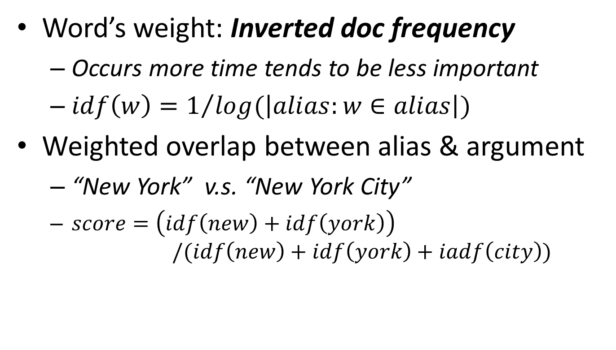
Entity Linking
Word’s weight: Inverted doc frequency
Occurs more time tends to be less important
$idf\left(w\right)=1/{log(\left|alias:w∈alias\right|)}$
Weighted overlap between alias & argument
“New York” v.s. “New York City”
$score=\left(idf\left(new\right)+idf\left(york\right)\right)$ $/(idf\left(new\right)+idf\left(york\right)+iadf\left(city\right))$
8
Notes:
then count the weighted overlap between an alias and an argument and choose the best entity with highest score

Slide 16
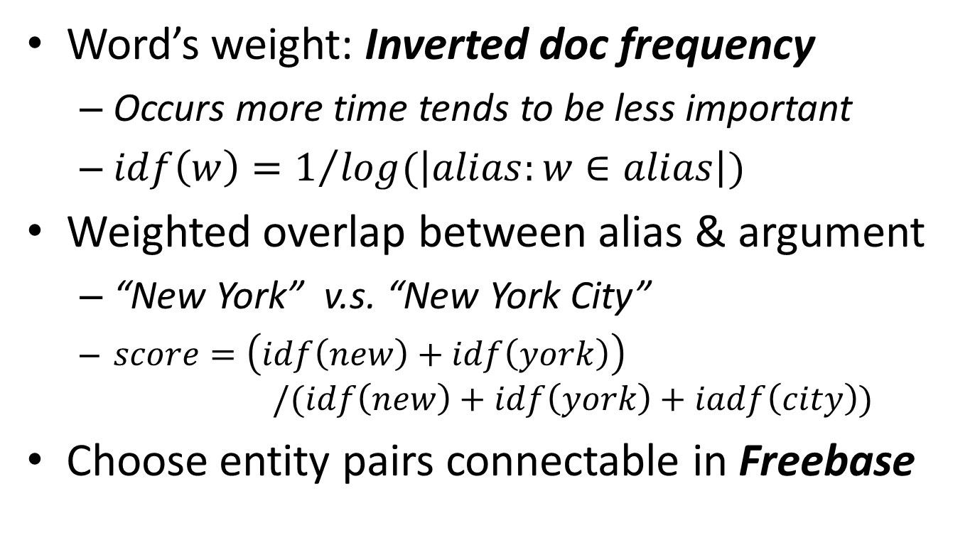
Entity Linking
Word’s weight: Inverted doc frequency
Occurs more time tends to be less important
$idf\left(w\right)=1/{log(\left|alias:w∈alias\right|)}$
Weighted overlap between alias & argument
“New York” v.s. “New York City”
$score=\left(idf\left(new\right)+idf\left(york\right)\right)$ $/(idf\left(new\right)+idf\left(york\right)+iadf\left(city\right))$
Choose entity pairs connectable in Freebase
8
Notes:
Also, we will more likely to choose the entity pairs if they are connectable in freebase.

Slide 17
Relation Grouping
Syntactic Grouping
Resolve tense & lemmatization
POS-tagging & lemmatization tools
9
Notes:
In relation grouping, we first do syntactic grouping. at this step, we mainly resolve tense and lemmatization by using pos tagging and lemmatize tools.

Slide 18
Relation Grouping
Syntactic Grouping
Resolve tense & lemmatization
POS-tagging & lemmatization tools
Example:
“lives in”
“recently lived in” → “live in” “had finally lived in”
“…”
relation pattern
(a representative of each group)
9
Notes:
for example, lived in, .... are all clustered into a same group with a representative relation pattern “live in”.

Slide 19
Relation Grouping
Semantic Grouping
Use Freebase relations to represent a ReVerb relation in a vector form
10
Notes:
then we further group relation patterns into semantically equivalent groups.
we use freebase relations to represent reverb relation in a vector form since freebase relations are more formal with a limited amount.

Slide 20
Relation Grouping
Semantic Grouping
Use Freebase relations to represent a ReVerb relation in a vector form
Relation pattern live in:
{ <arg, live in, arg> }
10
Notes:
take live in as an example, after syntactic grouping, we get a support set for live in,

Slide 21
Relation Grouping
Semantic Grouping
Use Freebase relations to represent a ReVerb relation in a vector form
Relation pattern live in:
{ <arg, live in, arg> }
entity linking
{ <ent, live in, ent> }
10
Notes:
then after entity linking, we can get a set of entity pairs

Slide 22
Relation Grouping
Semantic Grouping
Use Freebase relations to represent a ReVerb relation in a vector form
Relation pattern live in:
{ <arg, live in, arg> }
entity linking
{ <ent, live in, ent> }
if connectable in Freebase
10
Notes:
then we check if those entity pairs can be connected by freebase relations.

Slide 23
Relation Grouping
Example of Semantic Grouping:
live in
{
<ent_A, ent_B>
<ent_C, ent_D>
...
...
<ent_i, ent_j>
...
}
Freebase
1,2 hop-relations:
rel_1
rel_2
...
...
rel_k
...
rel_n
...
<
1: 0,
2: 3,
...
k: 1,
...
n: 2,
...
>
vector for live in:
11
Notes:
in this figure, pls focus on the blue arrows, we can see there are three entity pairs can be connected by a freebase relation number 2, thus, in the vector for live in, the second position’s value should be 3.

Slide 24
Relation Grouping
Example of Semantic Grouping:
live in
{
<ent_A, ent_B>
<ent_C, ent_D>
...
...
<ent_i, ent_j>
...
}
Freebase
1,2 hop-relations:
rel_1
rel_2
...
...
rel_k
...
rel_n
...
<
0,
0.80,
...
0.27,
...
0.53,
...
>
vector for live in:
$$sim_{1}\left(rel_{1},rel_{2}\right)=cosine(vec_{1}, vec_{2})$$
11
Notes:
after normalization, we can construct a vector for relation pattern live in.
then the similarity between two different relation patterns can be measured by a cosine calculation.

Slide 25
Relation Grouping
Semantic Grouping
Word2vec : represent words as vectors
12
Notes:
on the other hand, a deep learning tool word2vec is used. it can represent words as vectors. which is always used to find most similar words for a specific word.

Slide 26
Relation Grouping
Semantic Grouping
Word2vec : represent words as vectors
vec(live in) = vec(live) + vec(in)
12
Notes:
to get the vector of a relation pattern, we simply average the vector of all content words in it. like this example.

Slide 27
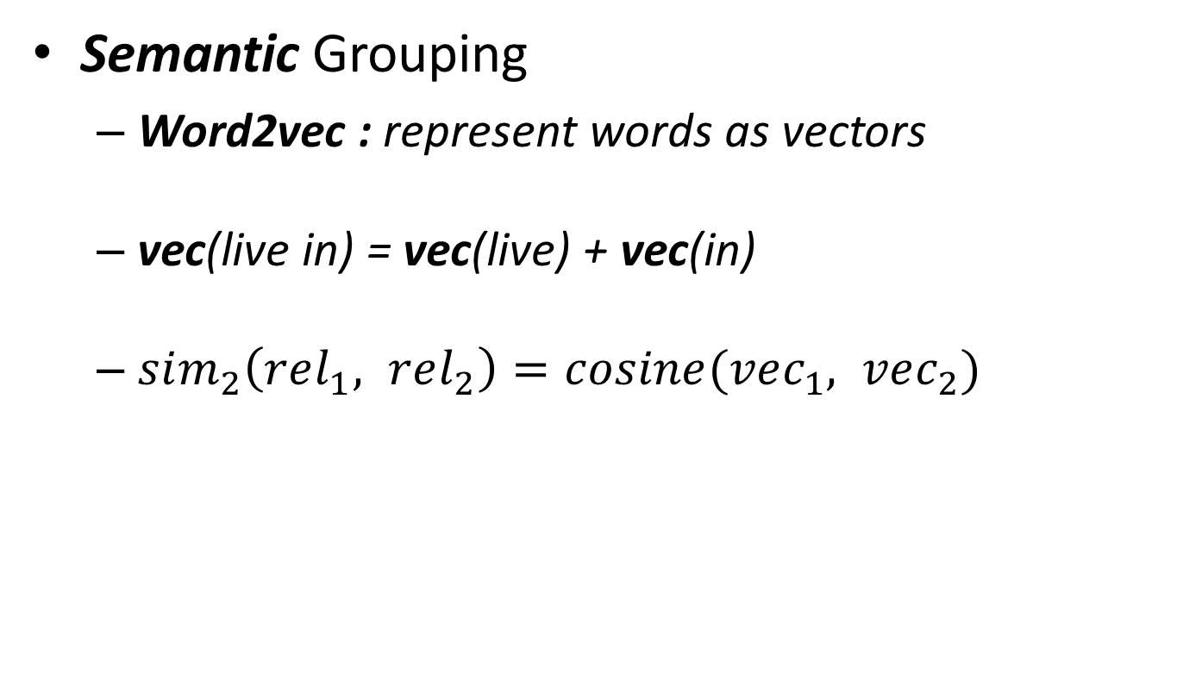
Relation Grouping
Semantic Grouping
Word2vec : represent words as vectors
vec(live in) = vec(live) + vec(in)
$sim_{2}\left(rel_{1}, rel_{2}\right)=cosine(vec_{1}, vec_{2})$
12
Notes:
then we can get the similarity in a similar way.

Slide 28
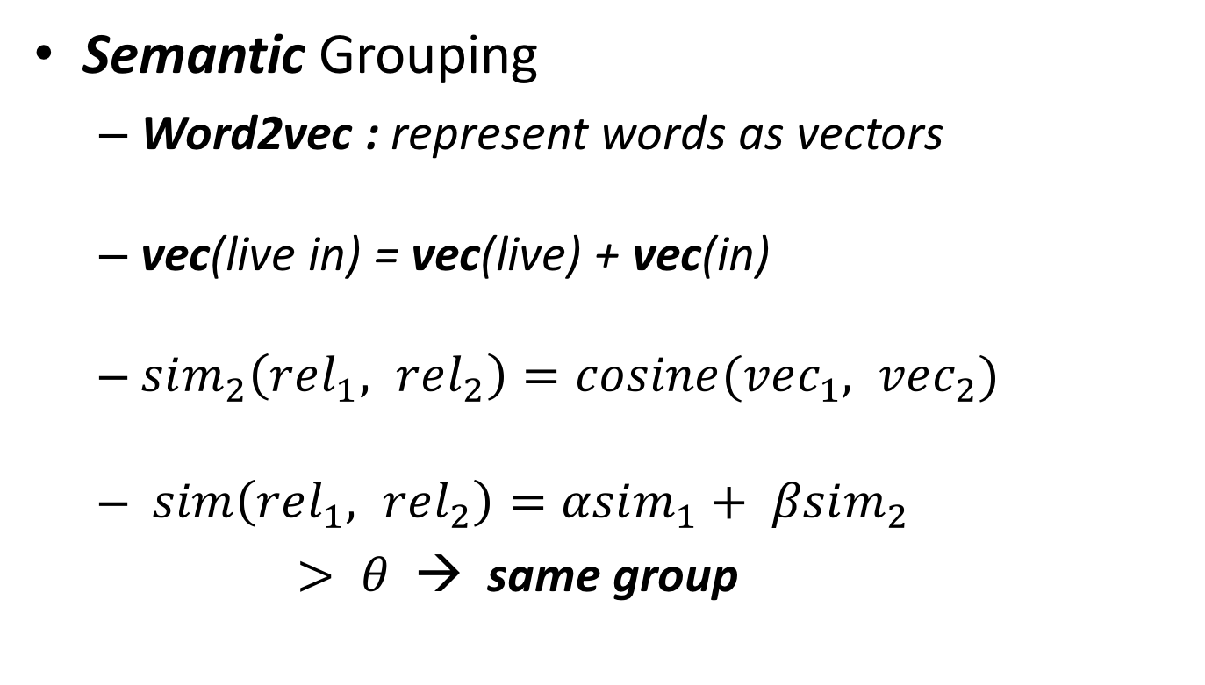
Relation Grouping
Semantic Grouping
Word2vec : represent words as vectors
vec(live in) = vec(live) + vec(in)
$sim_{2}\left(rel_{1}, rel_{2}\right)=cosine(vec_{1}, vec_{2})$
$sim\left(rel_{1}, rel_{2}\right)=αsim_{1}+ βsim_{2}$
$> θ$ → same group
12
Notes:
finally, we combine two similarity and the parameters will be determined in experiments.
if the similarity is greater than a threshold theta, than these two relation patterns will be grouped together

Slide 29
Predicate Extraction
Rule-based method
Lexical information of question
13
Notes:
in the step of predicate extraction, we mainly use a rule based method by analyzing the lexical information of question

Slide 30
Predicate Extraction
Rule-based method
Lexical information of question
POS-tagging, Lemmatization, NER …
Where does Obama live ?
question
word
auxiliary
verb
noun
phrase
verb+prep
13
Notes:
after performing pos-tagging, lemmatization and NER, the question can be analyzed as this:

Slide 31
Predicate Extraction
Rule-based method
Lexical information of question
POS-tagging, Lemmatization, NER …
Where does Obama live ?
question
word
auxiliary
verb
noun
phrase
verb+prep
rule: where do X verb-ph → verb-ph + in/at
Predicate: live in
13
Notes:
then we design a rule to extract the predicate live in.

Slide 32
Result
Where does Obama live?
14
Notes:
Now, I will show you the result of whole project. for a coming question. where does obama live

Slide 33
Result
Where does Obama live?
Live in
14
Notes:
we extract the predicate live in

Slide 34
Result
Where does Obama live?
Live in
live in, live at, reside in, be native at…
14
Notes:
find it’s paraphrases in the relation synsets we constructed.

Slide 35
Result
Where does Obama live?
Live in
live in, live at, reside in, be native at…
< Detroit, live in, the ATL., >
< Sveta, will reside in, USA >
...
14
Notes:
finally get reverb triples which contains the same predicate as the question.

Slide 36
Result
What two countries invaded Poland in the time of ww 2?
invade
invade, attack, declare war on, be invaded by…
< Japan, invaded, China >
< German, attacked, Poland >
...
15
Notes:
here is another example, invade, attack, ....

Slide 37
Result
What two countries invaded Poland in the time of ww 2?
invade
invade, attack, declare war on, be invaded by…
< Japan, invaded, China >
< German, attacked, Poland >
...
QA
15
Notes:
and the result can be further used in QA system.

Slide 38
Evaluation
Multiple steps
Randomly Pick & Human Judge
Entity Linking : 60% precision
Relation Grouping : 74% precision
Predicate Extraction : 84% precision
16
Notes:
Since there is no golden sets, we mainly use human annotation to evaluate the result for entity linking relation grouping and predicate extraction, the precisions are 60%, 74% and 84%respectively.

Slide 39
Conclusion
Provide a possible solution to further improve QA system via paraphrasing ;
17
Notes:
overall, this project provides a possible solution to further improve QA system via paraphrasing

Slide 40
Conclusion
Provide a possible solution to further improve QA system via paraphrasing ;
Construct ReVerb relation synonymous sets ;
17
Notes:
we construct the reverb relation synonymous sets, and it can be useful in other data mining tasks.

Slide 41
Conclusion
Provide a possible solution to further improve QA system via paraphrasing ;
Construct ReVerb relation synonymous sets ;
Part of work (entity linking, relation grouping) contributes to a paper “Inferring Binary Schema for Open IE” submitted to EMNLP 2015 ;
17
Notes:
lastly, part of work contributes to a paper inferring binary schema for open information extraction submitted to EMNLP 2015 which is still under review.

Slide 42
Thank you & QA

